Slide 1


“SMART GAS-LEAKAGE DETECTING SYSTEM”
Microcontroller and IOT Lab (B22EF0406)
Submitted by
ASHEEKA H N R22EF020
BHAVANA M S R22EF031

Slide 2


Introduction to Smart Gas Leakage Detector
This presentation will explore a cutting-edge smart gas leakage detector using the NodeMCU ESP8266 microcontroller. Learn how this innovative device can keep your home or business safe from the dangers of gas leaks.

Slide 3
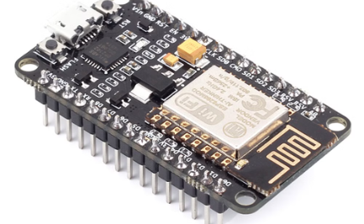
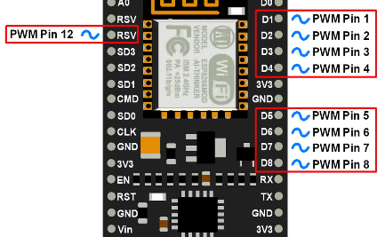
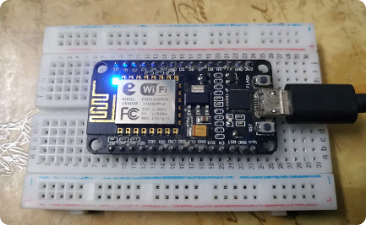
Overview of NodeMCU ESP8266
Powerful Microcontroller
Flexible Connectivity
Extensive Programmability
With built-in Wi-Fi and GPIO pins, the NodeMCU ESP8266 allows seamless integration with various sensors and devices, enabling wireless communication and control capabilities.
The NodeMCU ESP8266 is a compact, low-cost Wi-Fi enabled microcontroller board that packs a powerful 32-bit microprocessor, making it an ideal choice for IoT and smart home applications.
The board can be programmed using the Arduino IDE or the Lua-based firmware, providing developers with a user-friendly programming environment to create innovative IoT projects.

Slide 4
Importance of Gas Leak Detection
Safety Concern
Environmental Impact
Gas leaks pose a serious safety risk, potentially leading to fires, explosions, and health hazards. Prompt detection is crucial to prevent catastrophic incidents.
Undetected gas leaks can contribute to environmental pollution and climate change by releasing harmful greenhouse gases into the atmosphere.
Economic Implications
Health Concerns
Gas leaks result in significant financial losses due to wasted resources, property damage, and legal liabilities. Effective detection helps mitigate these costs.
Exposure to gas leaks can lead to respiratory issues, dizziness, and other health problems. Early detection is essential for protecting people's wellbeing.

Slide 5
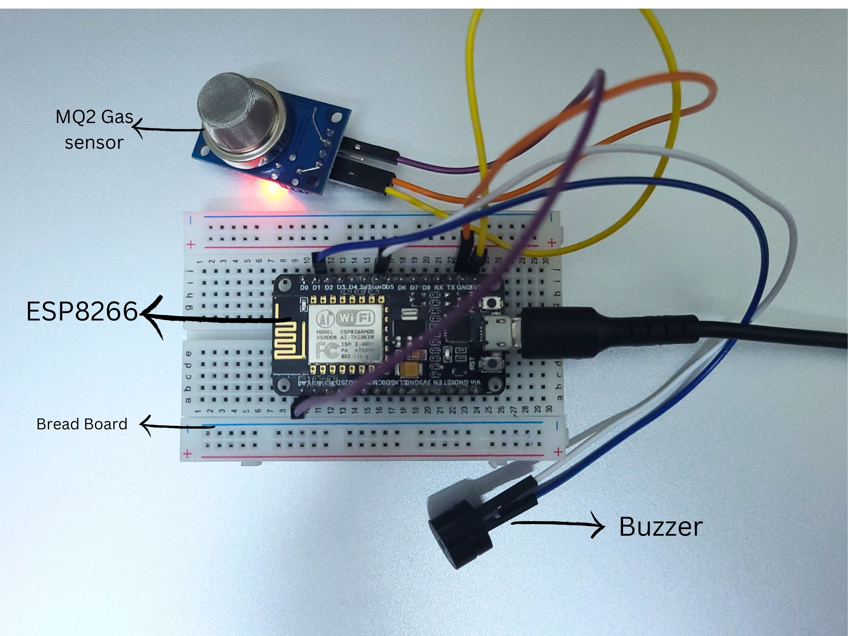
Hardware Components
The smart gas leakage detector system is built using the NodeMCU ESP8266 microcontroller, a highly-capable and Wi-Fi-enabled development board. It incorporates a MQ-2 gas sensor to detect the presence of combustible gases, along with a buzzer and LED for alarm notifications.
The system also includes a breadboard, jumper wires, and a power supply to ensure reliable operation. These hardware components work together to create a comprehensive solution for monitoring and alerting users to potential gas leaks in their homes or businesses.

Slide 6




Software Setup and Configuration
Flashing NodeMCU
1
Install custom firmware on the ESP8266 board
Programming Environment
2
Set up IDE (e.g. Arduino, PlatformIO) for coding
Libraries and Dependencies
3
Import required libraries for sensors and connectivity
The software setup for the smart gas leakage detector involves flashing the NodeMCU ESP8266 board with the appropriate firmware, configuring a programming environment like Arduino or PlatformIO, and importing the necessary libraries to interface with the gas sensor and connectivity modules. This lays the foundation for the code that will power the leak detection and notification system.

Slide 7
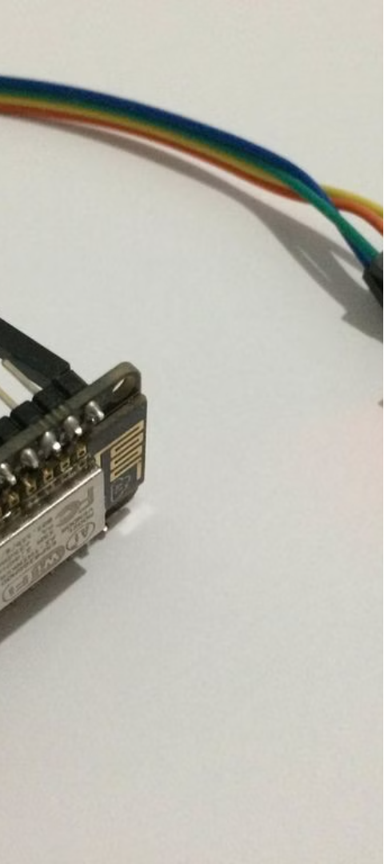


Sensor Integration
Gas Sensor
The core component is a highly sensitive gas sensor that can detect the presence of combustible gases like natural gas, propane, or methane.
WiFi Connectivity
The NodeMCU ESP8266 enables wireless communication to report sensor data and trigger alarms remotely.

Slide 8
Alarm and Notification System
1
Audible Alarm
The detector will trigger a loud, attention-grabbing alarm to alert occupants of a potential gas leak, ensuring immediate response.
2
Mobile Notifications
The system will send push notifications to the homeowner's smartphone, allowing remote monitoring and quick response even when away from home.

Slide 9
Data Logging and Analytics
Comprehensive Logging
Cloud-Based Analytics
The smart gas leakage detector will log critical data points such as gas concentration levels, sensor readings, alarm triggers, and timestamps. This comprehensive data will provide valuable insights into usage patterns and potential issues.
By securely transmitting the logged data to the cloud, users can leverage advanced analytics and reporting tools to gain a deep understanding of their gas usage and detect any anomalies or potential hazards.

Slide 10

Conclusion and Future Enhancements
In conclusion, this smart gas leakage detector using the NodeMCU ESP8266 provides a robust and reliable solution to address the critical issue of gas safety. The system's ability to detect leaks, trigger alarms, and notify users has the potential to save lives and prevent property damage.

